Slide 1

Module 3.6
Function libraries management

Slide 2
Functional libraries management
Notes:
This page intentionally blank

Slide 3
Library Manager Overview
Contains all the available objects for developing an automation project
  EFs (Elementary Functions)
  EFBs (Elementary Functions Blocks)
  DFBs (Derived Function Blocks)
  DDTs (Derived Data types)
Provides a set of functionalities allowing to modify the content of the library
Performs the transfers between the library and the project

Slide 4
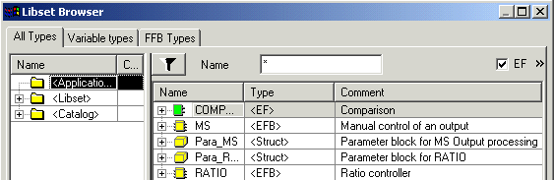
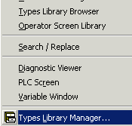
Types library manager
To modify the content of the global library <Libset> : add a new library / family, delete library / family, ...
To create a local library <Application> : transfer from the global library
To verify version coherence of the objects (global and local libraries)
To delete the unused types of the local library

Slide 5
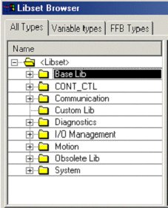
Provided Libraries
BASE LIB : with the groups Arrays,CLC_INT, Comparison, Date & Time, Logic, Mathematics, Statistical, Strings, Timers & Counters, Type to Type
CONT_CTL : with the groups Conditioning, Controller, Mathematics, Measurement, Output Processing, Setpoint Management
COMMUNICATION : with the Extended group containing 28 Communication FFBs
DIAGNOSTICS : with the Diagnostics group containing 15 Diagnostic FFBs
Note : New functions and function blocks in Unity V2.0 (See comments)
Notes:
New Type-to-Type FFBs in the Base Library:
REAL_AS_WORD
TIME_AS_WORD
UDINT_AS_WORD
WORD_AS_REAL
WORD_AS_TIME
WORD_AS_UDINT
New error registration FFBs in the Diagnosis Library:
REGEXT
UREGDFB
New Sysclock Family FFB in the System Library:
R_NTPC
New Lexium parameters management FFBs from Lexium Family in the Motion Library:
LXM_RESTORE
LXM_SAVE

Slide 6
Provided Libraries (cont'd)
I/O MANAGEMENT: with the groups Analog I/O Configuration, Analog I/O Scaling, Explicit Exchange, Immediate I/O, Interbus_S, Quantum I/O Configuration
MOTION : with the groups Axis Control, CAM Control, MMF Start
OBSOLETE LIB : with the groups CLC, CLC_PRO, Extensions/Compatibility
SYSTEM : with the groups Events, SFCManagement, SysClock

Slide 7
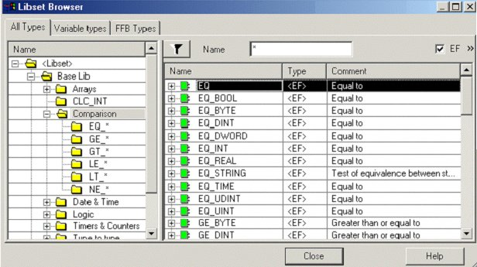
Libset Browser Expansion

Slide 8
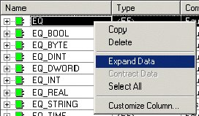
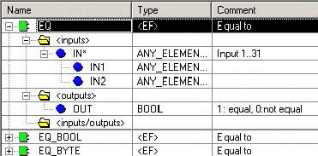
Libset Browser Expansion (cont'd)

Slide 9
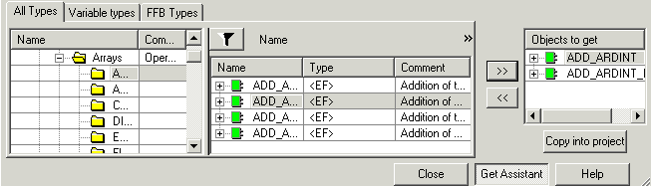
Transfer to local library
Open the Types library manager to transfer an object from the global library <Libset> to the local library <Application>
  Get Assistant to open the assistant (Objects to get window appear)
  Transfer objects to use in the application (>> control)
  Copy into project to transfer the objects in the local library <Application>

Slide 10
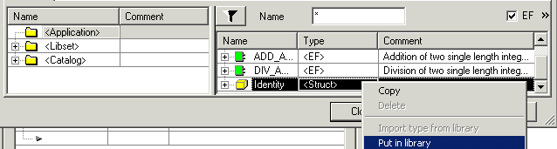
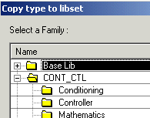
Transfer to global library
Open the Types library manager to transfer an object from the local library <Application> to the global library <Libset>
  Select the object to transfer (ie Identity structure)
  Put in library (right click on the object)
  Select the destination library / family than transfer (OK button)

Slide 11
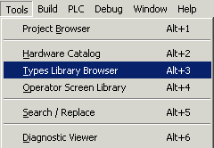
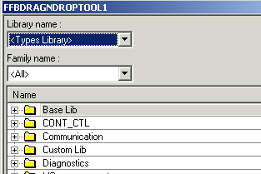
Access to a library
Tools menu to access to the libraries or catalog
  Hardware catalog : list of hardware equipments
  Types library : list of DDT, EF, EFB and DFB types
  Operator screen library : list of objects to define the operator screens

Slide 12
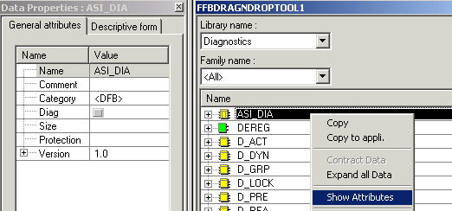
Types library browser
List of predefined variables types (array, structure, EF, EFB, DFB)
Drag & drop to use a variable type in the application (ie FBD editor)
Show Attributes to display the properties of the variable type

Slide 13
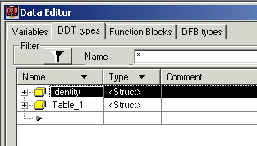
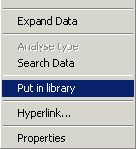
Store a DDT or a DFB type in a library
Only in local mode
Select the DDT or DFB type to archive
Active Put in library (right button of the mouse)
Select a family in the Custom Library
Copy the new type in the library (OK button)

Slide 14
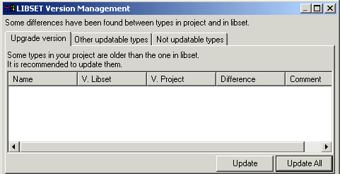
Version management
To verify the version coherence of objects in global and local libraries
  Check the version of objects used by project (in local library)
  Update one / all objects of the project

